Slide 1
A renewed "Call to Action" on SRHR-HIV linkages: Advancing towards universal health coverage

Slide 2
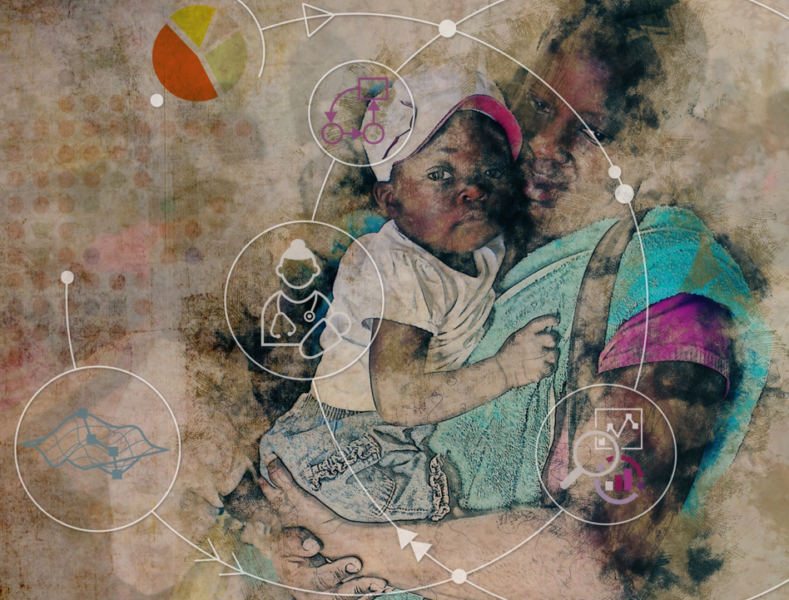
Research and Implementation Team
Dr G Mhlanga, MOHCC
Dr O Mugurungi, MOHCC
Dr T Magure, NAC
Dr Simukai Zizhou, MOHCC
Amon Mpofu, NAC
Fatima Mhuriro, MOHCC
Kudakwashe Takarinda, MOHCC
PMDs, DNOs and health facility staff of al 4 study provinces
Marelize Gorgens, World Bank
Jed Friedman , World Bank
Mead Over, World Bank
Svetlana Pivovarova, World Bank
Caroline Mudondo, World Bank
Gerald Shambira, World Bank
Tushar Malik, World Bank
Melusi Ndhlalambi, World Bank
Nigel Herath, World Bank
Chiara Dellaira, World Bank
Munhamo Chisvo, Jimat
Gilbert Mawera, Jimat
Gideon Gavera, Jimat
Albert Machisvo, Jimat
Deveria Banda, Jimat
Jimat supervisors and field team
Team from UZ-UCSF (led by Dr
Mbizvo) for baseline assessment
Presented by
Dr T Magure
Chief Executive Officer
Zimbabwe National AIDS Council

Slide 3
SRH/HIV integration status in Zimbabwe in 2010: rapid assessment
HIV and SRH services inequitably funded
Occurs by default at PHC level
Uncoordinated
Uninformed by policies and hampered by inadequate training
No follow up mechanisms
Staffing constraints
Lack of access to GBV services & cervical cancer screening
Duplicate recording of the same data imposing a significant time-cost to staff
Decision taken that a national HIV-SRH linkages programme was needed

Slide 4
Zimbabwe’s HIV and SRH Linkages Programme Objectives
Advocate for integrated SRHR and HIV programme delivery and funding support
Facilitate bi-directional linkages within SRHR and HIV policies, strategies, guidelines and plans
Strengthen management capacity to plan, support implement, monitor and evaluate integrated SRHR and HIV prevention, care and support services
Review SRHR and HIV protocols, manuals and tools to reflect integrated HIV and SRHR programming.
Strengthen the capacity of service providers to implement integrated SRHR and HIV prevention, care and support services
Impact evaluation to assess efficiency gains

Slide 5
Support for Zimbabwe’s Programme on SRH and HIV Linkages and Integration
EU-funded project focusing on guidelines and implementation
Regional project in 7 countries in Southern Africa: (Malawi Botswana, Namibia, Zambia Swaziland Lesotho, Swaziland, and Zimbabwe) in overcoming barriers to strengthening linkages between SRHR and HIV policies, programs and services
Support from DFID through the Integrated Support Programme to improve integration at select facilities
World Bank and DFID technical and financial support for impact evaluation to assess cost effectiveness of integration: effort to evaluate efficiency gains through HIV-SRH integration
This presentation focuses on the key lessons learned from impact evaluation

Slide 6
Promoting and Inhibiting Factors to Integration relevant to evaluation design
Promoting
Stakeholder involvement
Capacity building
Positive staff attitudes and non-stigmatizing services
Engagement of key populations
Inhibiting
Lack of sustainable funding and stakeholder commitment
Staff shortages, high turnover or inadequate training
Poor programme management and supervision
Inadequate infrastructure, equipment, and commodity supply
Client barriers to service utilization, including low literacy, lack of male partner involvement, stigma, and lack of women’s empowerment to make SRH decisions
Notes:
Factors promoting and inhibiting successful integration as reported by the studies were extracted. Themes that emerged across studies are listed here.

Slide 7
Impact Evaluation Design
Randomized encouragement of integration in 50% of districts in 4 provinces in Zimbabwe
Outputs, costs, patient experience and quality data collected for the year 2013 and the year 2016
Key focus on ensuring that quality did not decline as a result of integration of services
Specific service integration focused on
HIV services into family planning
HIV services into ANC
SRH services into ART clinics

Slide 8
Research questions
What is the most useful way to define and measure HIV/SRH integration?
What is the most useful way to define and measure the “efficiency” of HIV and SRH services in the Zimbabwe context?
What is the observed correlation between “efficiency” and “integration” at the baseline and at the endline?
Does any changes in integration or efficiency affect quality of care and if so, how?
Does a randomized promotion of “integration” significantly increase measured integration?
If so, what is the estimated effect of “integration” on efficiency?
By what channels does “integration” affect efficiency?

Slide 9
Where Was It Implemented?
4 Provinces
15 Districts
89 Facilities (PHC & Hospitals)
Mash West
Mash East
Sanyati
Mhondoro
Ngezi
Masvingo
Mat South

Slide 10
Intervention Implemented to promote integration
To ensure exogenous variation in integration, randomized encouragement intervention implemented
15 of the 31 study districts chosen for intervention
4 rounds of supportive supervision focusing on integration
At each round, determine integration score per supervision visit
After every round, two prizes awarded in each province:
1 prize for best district ($3500) and 1 prize for most improved district ($3500)
Winning districts publicly acknowledged in ceremony held by PMD

Slide 11
Intervention Implementation Results: change in integration score (from supervision visits) over rounds of supervision
Mashonaland East Province Mashonaland West Province

Slide 12
Intervention Implementation Results: change in integration score (from supervision visits) over rounds of supervision
Masvingo Province Matabeleland South Province

Slide 13
Results: Did integration increase over time and between intervention and control sites?
The impact evaluation created an integration index using principal component analysis (PCA) of selected variables
In using the PCA method, several variations of variable selection and composition were tested
Also tested the used of another index (Integration Index from Integra Study)
More HIV services were offered per client and a higher proportion of clients is offered both HIV and SRH services in district hospitals

Slide 14
Results: Did integration increase over time and between intervention and control sites?
More SRH services are offered at the PHCs and a higher proportion of clients receives both HIV and SRH services.
Integration index shows:
Significant increase in the integration in the district hospitals in the intervention districts over time,
No significant change at the PHC levels: This is understandable, given that integration happens ‘by default’ at PHC levels (where there is typically only 1 or 2 service providers)

Slide 15
Other findings: Patient Experience
The experimental treatment improves patient experience by offering multiple services in the same visit and by facilitating “continuity of care” and “linkage”
Patient experience is an important consideration in the context of integration and quality of services in universal health coverage achievement
Detailed findings presented at the conference this week

Slide 16
Conclusions
As countries move towards UHC, the integration of services will become more common field
Lifecycle approach to a client interacting with the health system at different stages of his/her life
Needs a new approach to monitoring and tracking of results
New regional HIV-SRH project will take indicators and measurement lessons from this IE into account
In the context of integration, measuring of marginal costs and cost functions that takes into account all that the facility produces, is essential
Service integration also means new ways of counting outputs (services) delivered by a facility
Needs patient-centred monitoring and thus civil registration systems to ensure unique identifiers to track patients throughout their life cycle
Partial studies that measure partial outputs delivered by a health facility, is less useful
Patient-reported experiences and patient-reported outcomes should become an integral part and is the missing middle of what does not currently get measured

